Slide 1

ESILV - Python for data analysis - project 2022
Presented by:
HACHEM Mohamad
BENYEMNA Hamza

Slide 2
Outline:
Introduction to the topic ?
The goal of the project
Presentation of the dataset
Present the data manipulation and visualization
Present the Machine Learning models
Conclusion

Slide 3

Topic :
Diabetes is a chronic (long-lasting) health condition that affects how your body turns food into energy. To put things into perspective, 34.2 million US adults have diabetes, and 1 in 5 of them don't know they have it. Diabetes is the seventh leading cause of death in the United States.
Is it possible to bring these numbers down by using data and Machine Learning ?

Slide 4
General context:
In our problem we will study the trait of being readmitted after treatment of his/her diabetes.
Why is such point so important ?
It let us see if the treatment was valid for the patient.
It will make us better at predicting who are the people who are more likely to be readmitted; therefore, be better prepared.
Yes
Patient
Readmitting
Hospital
NO

Slide 5
The goal of the project:
Now that we know what are we trying to study exactly, so what is our goal ?
It is to predict as accurately as possible how likely is it for a patient to be readmitted. In our problem there are 3 states for being readmitted.
NOT readmitted.
Readmitted before 30 days
Readmitted after 30 days
This work need skills in:
Data cleaning.
Data visualization.
Machine Learning.
We must get a dataset as clean as possible in order to provide the best model. Furthermore, we must make many tests with different models. After this, we must compare our results to find out the best one.

Slide 6
Presenting the dataset (1/2):
Feature_ID | Feature name
37 | miglitol
38 | troglitazone
39 | tolazamide
40 | examide
41 | citoglipton
42 | insulin
43 | glyburide-metformin
44 | glipizide-metformin
45 | glimepiride-pioglitazone
46 | metformin-rosiglitazone
47 | metformin-pioglitazone
48 | change
49 | diabetesMed
50 | readmitted'
Our dataset contains originally 50 features sited as follow with color coded.
Feature_ID | Feature name
1 | encounter_id
2 | patient_nbr
3 | race
4 | gender
5 | age
6 | weight
7 | admission_type_id
8 | discharge_disposition_id
9 | admission_source_id
Feature_ID | Feature name
10 | time_in_hospital
11 | payer_code
12 | medical_specialty
13 | num_lab_procedures
14 | num_procedures
15 | num_medications
16 | number_outpatient
17 | number_emergency
18 | number_inpatient
Feature_ID | Feature name
19 | diag_1
20 | diag_2
21 | diag_3
22 | number_diagnoses
23 | max_glu_serum
24 | A1Cresult
25 | metformin
26 | repaglinide
27 | nateglinide
Feature_ID | Feature name
28 | chlorpropamide
29 | glimepiride
30 | acetohexamide
31 | glipizide
32 | glyburide
33 | tolbutamide
34 | pioglitazone
35 | rosiglitazone
36 | acarbose

Slide 7
Introducing the Dataset (2/2):
Now that we seeing our features, we will classify them by IDS according to their functionality and they are color coded as the previous dataset.
IDS
Others
Features number:
1,2,7,8,9
10 =>24
Features number:
Belong to
Belong to
Features number:
Drugs
Target
25 => 48
Feature number:
50
Belong to
Belongs to
3,4,5,6
Human features
Features number:
Belong to

Slide 8

Our solution:
Now that we understood more about the topic, and we saw the dataset, we are working with let’s see how did we proceed to solve this issue.
The method used has 2 main parts:
First part includes data cleaning and visualizations.
Second part includes Machine Learning models.

Slide 9

Data cleaning:
To be able to work with ease with our dataset, we had to start by data cleaning and so we did the following:
Removed the duplicated entries from our dataset (from 101766 to 71518 rows which represents 30% of the dataset).
Removed any useless feature. Some columns such as the weight were full of ‘?’ with only 2853 rows with no missing data (3% of the dataset). Moreover, we removed all the drugs that has less than 5% impact.
Transforming the dataset into numeric values. This helps us to make correlations and studies that require to compare the different features.
This way, having a lighter and homogeneous dataset with no missing data simplifies the work and let us focus on the essential aspects of the predicting work.

Slide 10
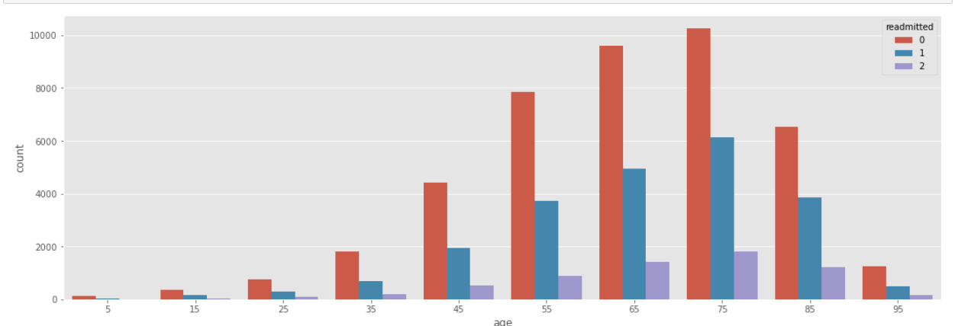
Plot of age:
Data visualization (1/3):
This work of visualization helps us to point at important features. The aim is to keep essential features as predictors.
As we can see, patients around 75 years old are more concerned by readmission.

Slide 11
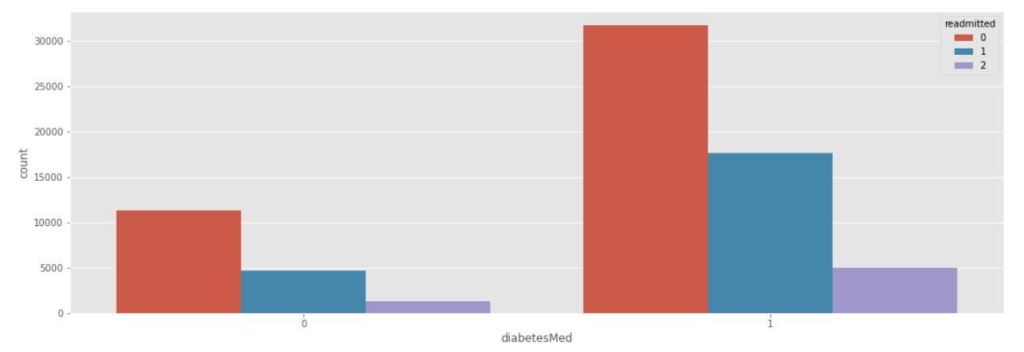
Plot of diabetes medications:
Data visualization (2/3):
We can say that readmitted has the same distribution for the people with or without diabetes medications in terms of proportions between no readmission, < 30 days and > 30 days. But it is interesting to add that the patients that have medications are more concerned by readmission than the ones with no medications (3x more).

Slide 12
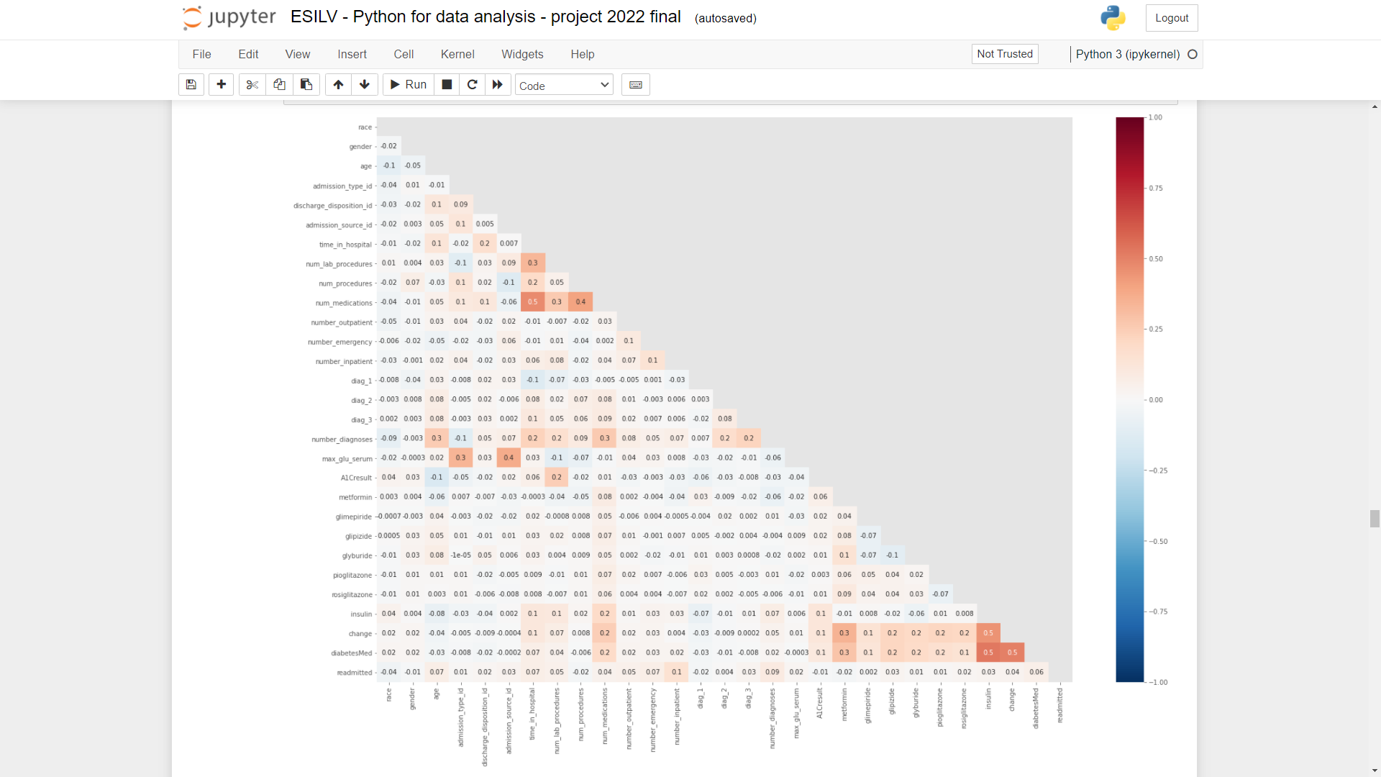
Plot of correlation:
Data visualization (3/3):
In the following plot we can see the correlation between all the features. And the reason to do so is to understand which features should be removed while we are training our dataset.
The most interesting ones are :
number_inpatient (0.1).
number_diagnoses (0.09).
number_emergency (0.07).
age (0.07).
diabetesMed (0.06).
We notice that there isn't any strong correlation with the target (no one has more than 0,1).

Slide 13

Machine Leaning:
Now that we cleaned our dataset, we are ready to creating some machine learning models. In order to do that, we need to:
Identify the model we want to work on.
Split the data into training and testing set.
Scale the data.
Run the machine learning algorithm.
Proceed to validation test.
Try to improve it.

Slide 14
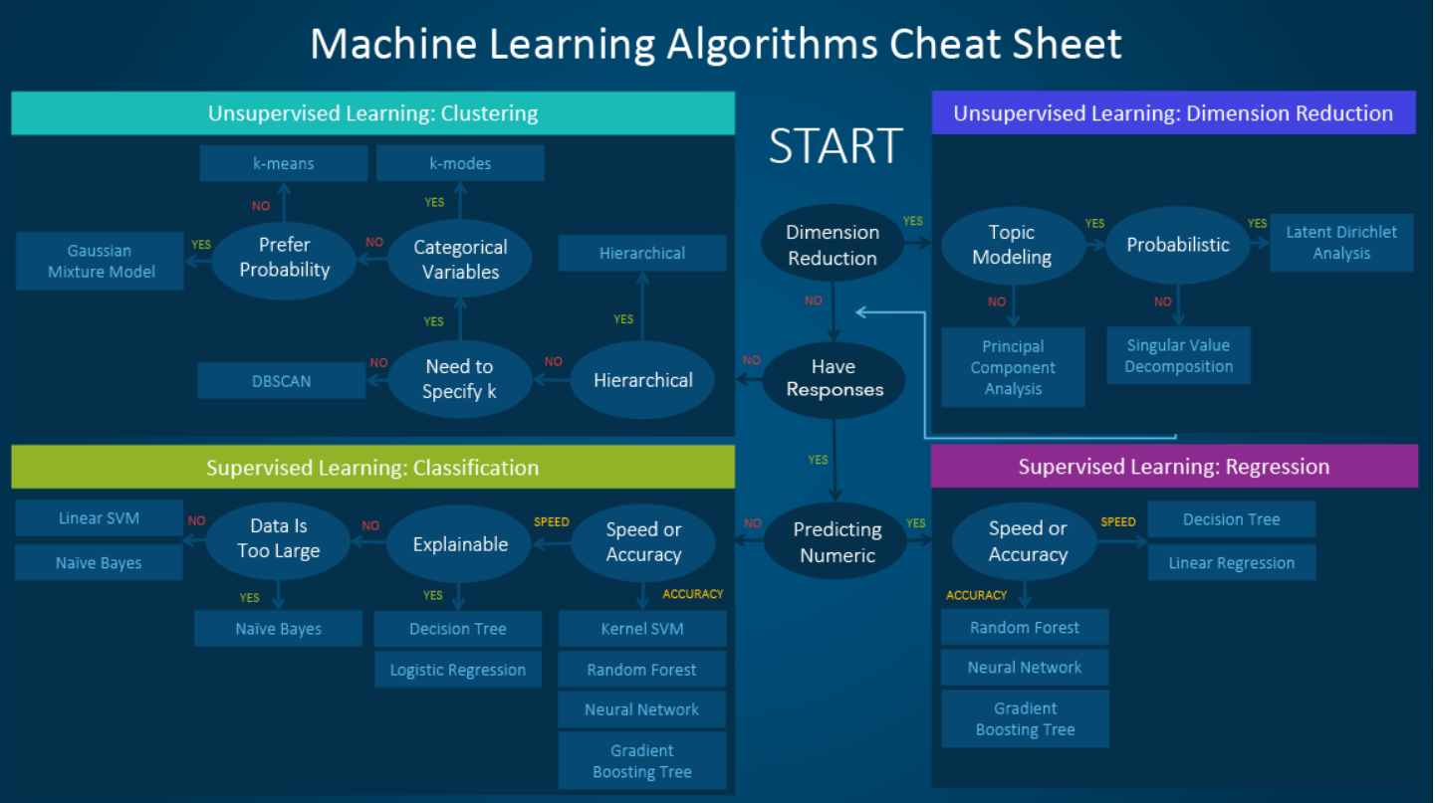
Explanation of Machine Learning:
Schema of different possibilities:
Since our problems deals in knowing whether our patient will be readmitted or not. Then we are dealing with a 3-class problem with a labelled dataset. Indeed, it is a supervised model of classification.
So, according to this schema, we picked out 3 methods:
Naïve Bayes.
Random Forest.
Gradient Boosting Tree.
We chose Naïve Bayes model in order to test the speed of this method and the other two because we aim for accuracy.

Slide 15
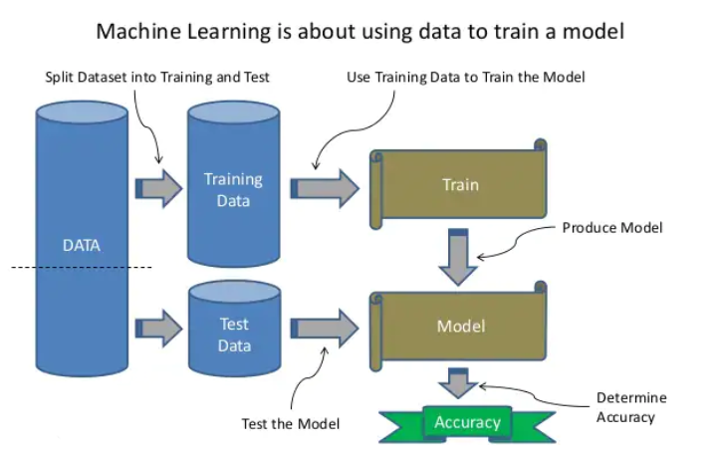
Splitting the data:
To be able to start our model, we need to first split our data into a training and a testing set to work on it. There is different ways of doing so. Usually, we split this ways:
80% for training / 20% for testing.
~70% for training / ~30% for testing.
We decided to use 1/3 of the dataset to test and the other 2/3 to train.
After that, we split the testing set into 2 parts (50/50) for the validation test.

Slide 16
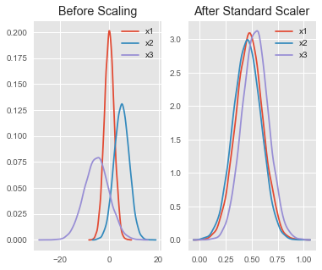
Scaling the data:
Scaling the data makes building a machine learning algorithm way easier and more accurate so it is very important to do that.
As seen in this plot, the data is heterogeneous before the scaling. The Standard Scale method that we used bring all the data to the same range. This way, the variance of the data will not affect our work on the accuracy through many attempts.

Slide 17
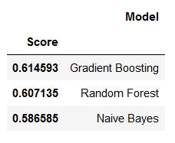
Different Machine Learning models:
We can see the accuracy rate for each model that we applied on the dataset. The accuracy score obtained is around 60,5-62,5%.
There are 3 important outcomes to talk about:
Naive Bayes is the fastest and the one.
Gradient Boosting is the best model.
Based on that, we decided to keep working on the Gradient Boosting model (since it provided us with the highest accuracy) but before that, we tried to improve these results in order to be sure of our model choice.

Slide 18
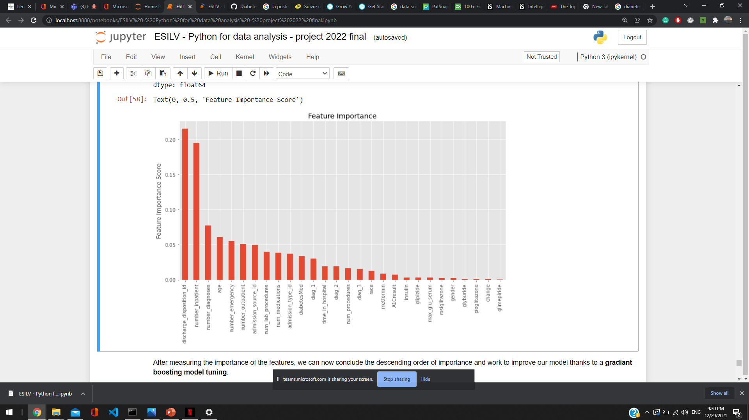
Variable importance:
This bar plot shows us the importance of the features on the model's accuracy. We can say that discharge_disposition_id and number_inpatient are the most important features with a score about 0,20.
We noticed that the features with less than 0,02 importance score do not affect the accuracy that much.

Slide 19
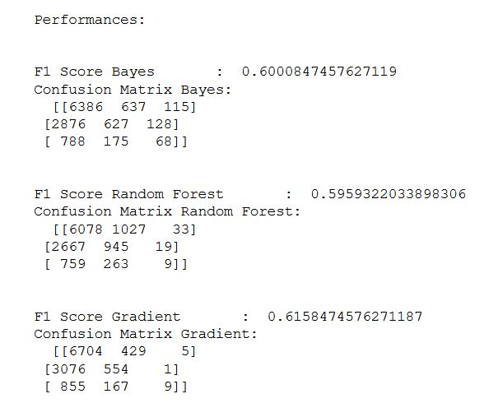
Improvement of the model:
Indeed, we first tried our models on the dataset with different combinations of features according to the importance score.
We started choosing from 1 (with the highest importance) all the way to 27 predictors (total list of features). We noticed after many attempts that:
The less we have features(less than 5), the more Naïve Bayes model is the best. Random Forest and Gradient Boosting models shows some limits with less data.
The more we have features, the more Gradient Boosting has the best accuracy.
Running time and accuracy increase deeply with the number of predictors selected.
Besides this, we proceeded to validation test that shows confusing matrix and accuracy score. We still in an accuracy rate around 60%-62,5%. Therefore, the improvement is not obvious, that is why we tried the Gradient Boosting Model Tuning.

Slide 20
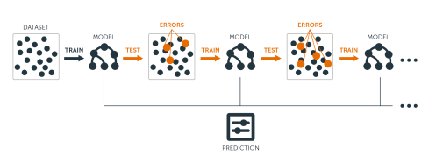
Gradient Boosting Model Tuning:
Based on the Gradient Boosting model that we chose; we applied a hyper parameters tuning method. As explained in the schema, this method is based on the crossing of different results in order to create a more powerful model.
So, we first initialize the parameters according to basic criteria to be able to use a grid search method.
This method is based on intuition and testing many times in order to find the best n_estimators parameter by fumbling. We noticed that the more the parameters are high, the more the grid search take time to return a result.
This way, we could obtain the best score.

Slide 21
Conclusion:
By simply taking data from diabetes patients and treating them, we can help them out by predicting whether a patient will need to be treated again any time soon
Through our Machine Learning model based on Gradient Boosting which is boosted by the Model Tuning thanks to a grid search, we were able to have an accuracy that reached 62,5%.

